Slide 1

Statistics
Art of Making Decisions in the light of uncertainty

Slide 2
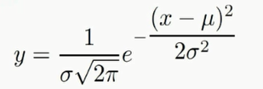
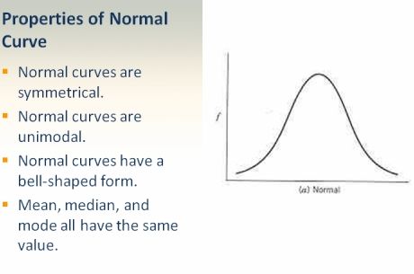
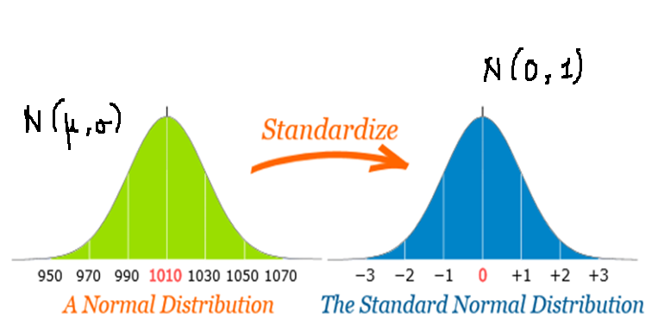
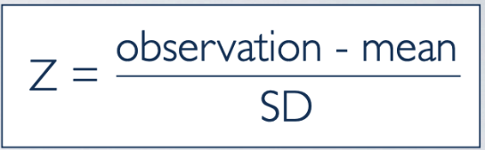
Normal Distribution vs Standard Normal Distribution

Slide 3

Central Limit Theorem
Mean of all sample of population ~ mean of population as number of observations in sample increases.
Sample would be normal distributed if n>30 even population is normally distributed or not.
Sample would be normal distributed but population should be normally distributed (In case of n<30)

Slide 4
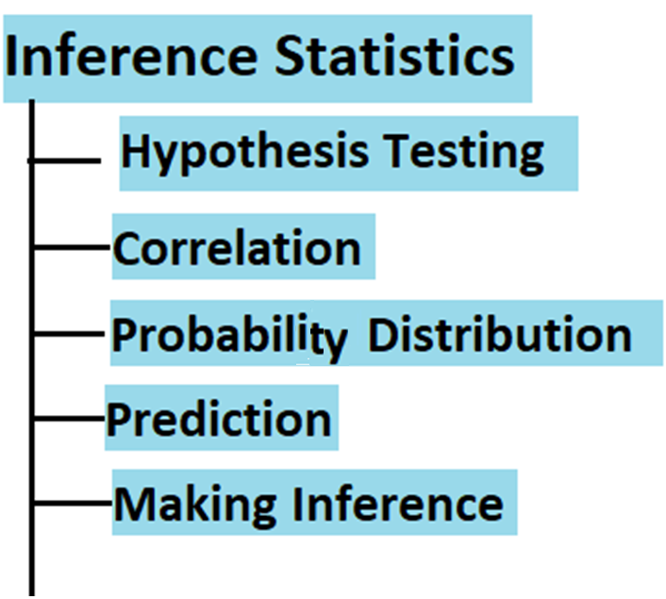
Inference Statistics

Slide 5
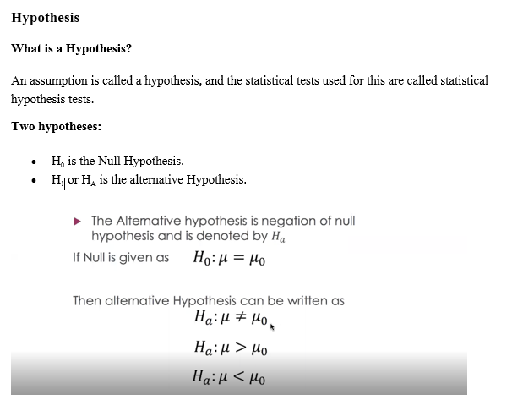
Hypothesis Testing
Null Hypothesis : Ho : no Change : Neutral
Alternate Hypothesis : H1 : alternate of Null Hypothesis
Uses in statistics and machine Learning.
Comparison
Relationship
Other Examples : Clinical Trial, Court Justice.

Slide 6
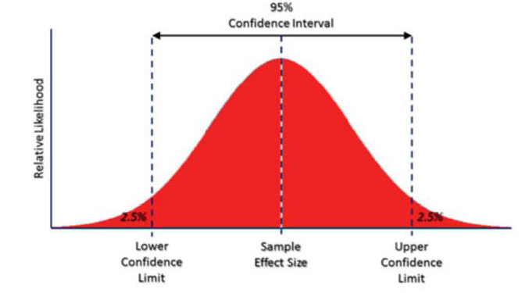
Confidence Interval
P is Low, Null Must Go

Slide 7
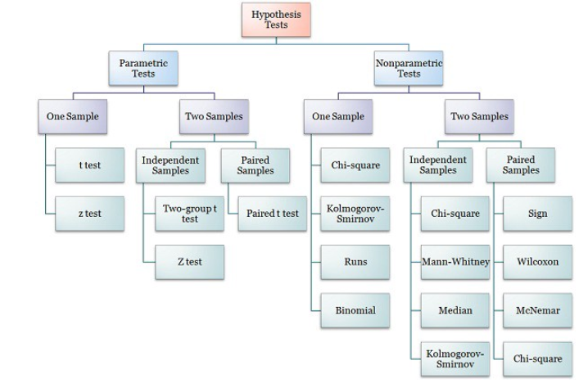
Hypothesis Tests

Slide 8
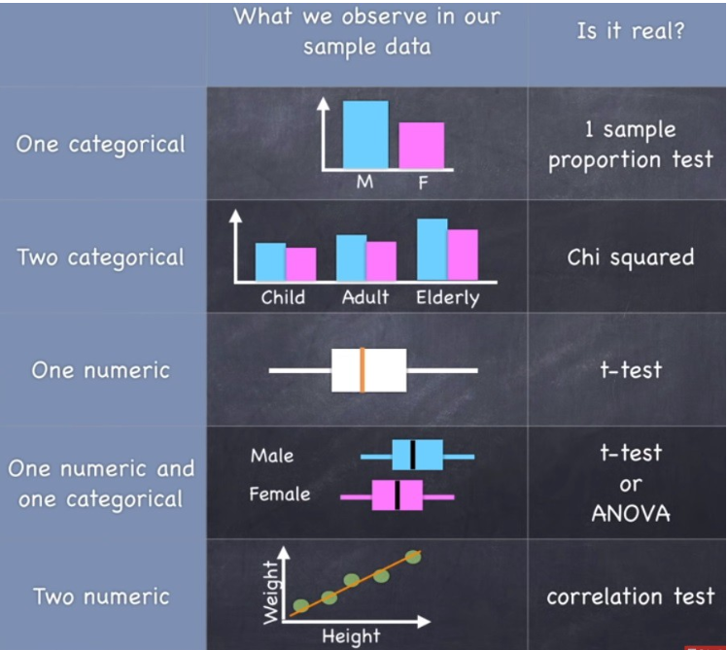

Slide 9
Z-Test
( the sample is assumed to be normally distributed ) (population mean and population standard deviation are known) Used to validate hypothesis that the sample drawn belongs to the same population. Null : Mean of sample = Mean of population Alternate : Mean of sample ≠Mean of population

Slide 10
T-Test
( the sample is assumed to be normally distributed ) (population mean and population standard deviation are known) Used to compare the mean of only two given samples. ( for three , we used ANOVA). 3 Types of T-Test : One sample , Independent and Paired. Large T-Test Score = group are different Small T-Test Score = Group are same
Null : Mean of one sample = Mean of other sample Alternate : Mean of other sample ≠Mean of other sample

Slide 11
ANOVA Test ( Analysis of Variance ) :
(random sample, Homogeneity, Normality)
(2 Types of Anova: One Way Anova and Multi-Way Anova ) Used to compare multiple (three or more) samples with a single test/multiple tests and used to compare datasets as well. Null : All samples are equal Alternate : All samples are not equal

Slide 12
CHI-Square Test (χ2)
Chi-Square Test (χ2) ( Comparison and Categorical ) Used to compare 2 or more categorical variables. Types : i. Goodness of fit test, which determines if a sample matches the population. ii. A chi-square fit test for two independent variables is used to compare two variables if the data fits. a. A small chi-square value means that data fits b. A high chi-square value means that data doesn’t fit. Null: Variable A and Variable B are independent Alternate: Variable A and Variable B are not independent.

Slide 13
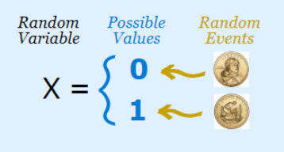
Probability
Measurement of uncertainty
Independent Events: A and B are independent iﬀ:
P(A ∩ B) = P(A)P(B)
P(A|B) = P(A)
P(B|A) = P(B)
Conditional Probability: P(A|B) = P(A,B)/P(B)
Bayes Theorem: P(A|B) = P(B|A)P(A)/P(B)
Joint Probability: P(A,B) = P(B|A)P(A)
Marginal Probability: P(A)

Slide 14
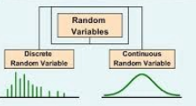
Probability Distribution Function
function that describes the likelihood of obtaining the possible values that a random variable can assume.
Probability distributions describe the dispersion of the values of a random variable. Consequently, the kind of variable determines the type of probability distribution
Two Types of Distributions:
Probability Mass Functions for discrete variables ( PMF )
Probability Density functions for continuous variables ( PDF )

Slide 15
Discrete probability mass distributions functions where each particular value has a non-zero likelihood,
Specific values in continuous distributions have a zero probability. For example, the likelihood of measuring a temperature that is exactly 32 degrees is zero.

Slide 16
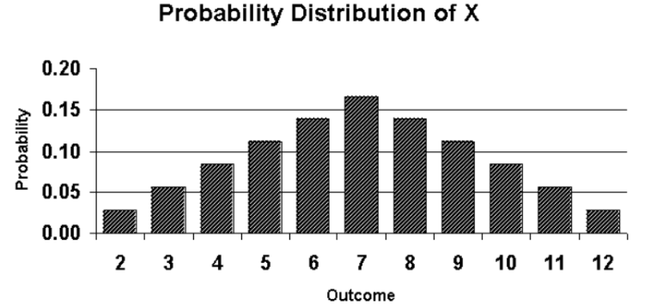
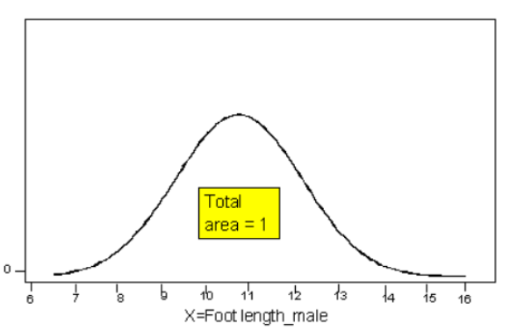

Slide 17
Types of Discrete Distribution
Binomial distribution to model binary data, such as coin tosses.
Poisson distribution to model count data, such as the count of library book checkouts per hour.
Uniform distribution to model multiple events with the same probability, such as rolling a die.
Power Distribution : change in one quantity varies as a power of another quantity, measure the inequality in the world. e.g. wealth, word frequency

Slide 18
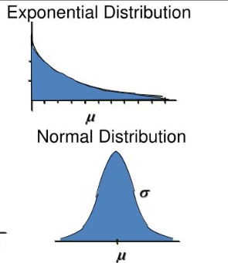
Types of Continuous Distribution
Gaussian – Normal Distribution-Bell Curve
Exponential Distribution
Gamma Distribution
Beta Distribution

Slide 19
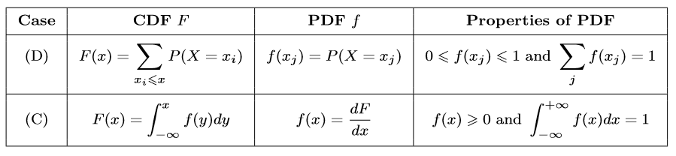
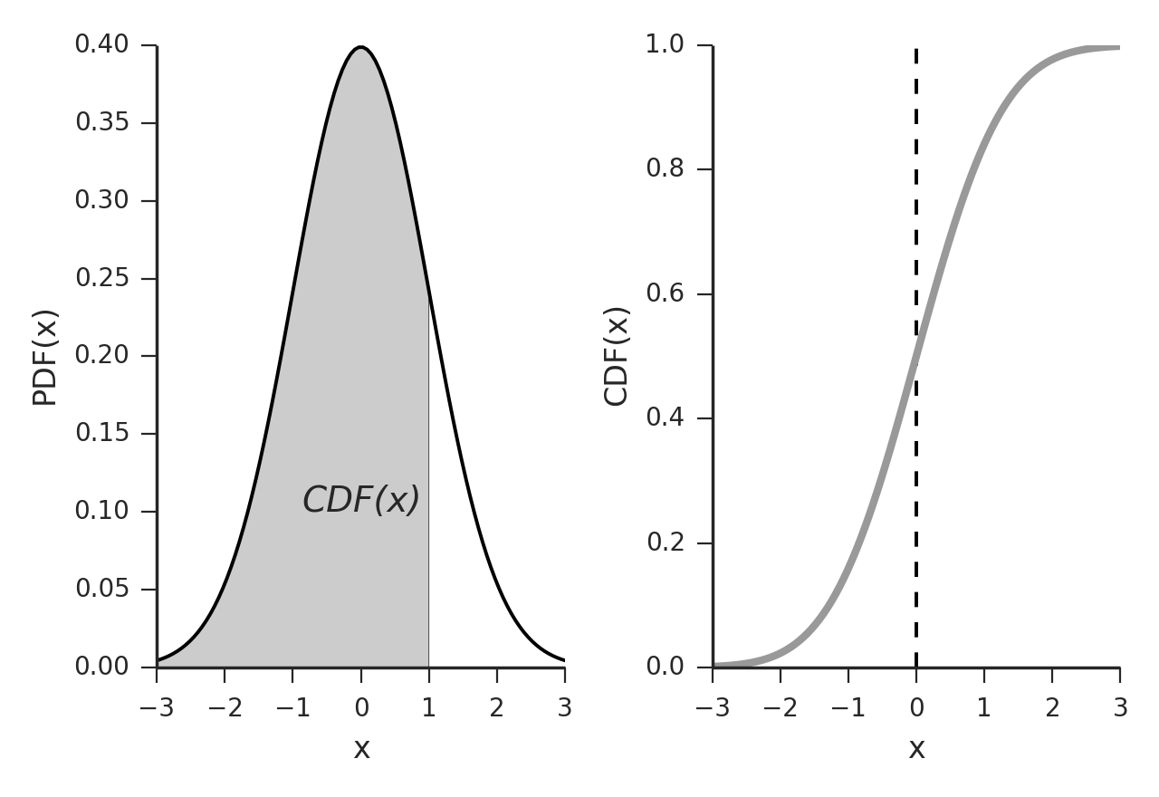
Probability Density Function (PDF) Gives the probability that a rv takes on the value x: pX(x) = P(X = x)
Cumulative Density Function (CDF) Gives the probability that a random variable is less than or equal to x: FX(x) = P(X ≤ x) Note: The PDF and the CDF of a given random variable contain exactly the same information.

Slide 20
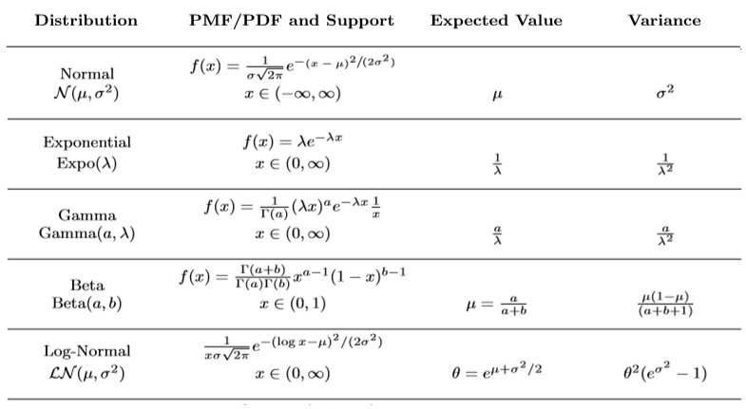
Continuous Probability Distributive Function

Slide 21
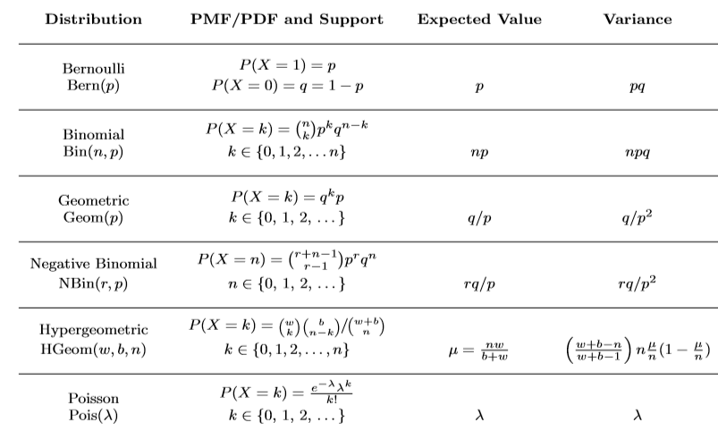
Discrete Probability Function Distribution

Slide 22
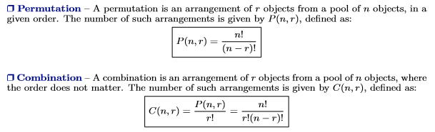
Permutations vs Combinations

